Slide 1

Databases project
COMPANY NAME

Slide 2

SDG 3:Problem Definition
Subtitle
Date

Slide 3
SDG 3: Good Health and Well-Being
Project Overview
SDG 3: Good Health and Well-Being
Focus: Addressing childhood obesity by analyzing dietary habits and physical activity levels among children.
Significance
Health Risks:
Immediate: High blood pressure, insulin resistance, respiratory problems.
Long-term: Type 2 diabetes, stroke, certain cancers.
Psychological Impact:
Low self-esteem, depression, anxiety.
Impacts academic performance and quality of life.
Economic Burden:
Increased healthcare costs.
Reduced productivity.
Social Equity:
Disproportionate effect on low-income families, exacerbating inequalities.

Slide 4

Data-Driven Solution
Proposed Solution
Relational Database: Collect data on children's dietary intake, physical activities, and health metrics.
Data Analysis: Utilize SQL and Excel to identify patterns and insights.
Interactive Dashboard: Visualize key findings and provide actionable insights.
Objectives
Improve Dietary Habits: Identify unhealthy eating patterns, promote balanced diets.
Increase Physical Activity: Analyze activity data, encourage regular exercise.
Support Policy and Decision Making: Provide data-driven insights to stakeholders.

Slide 5
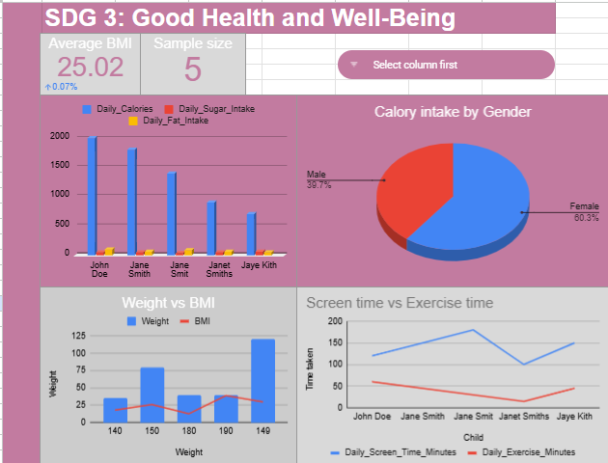

Slide 6


Insights
More Female children are indulging in high calorie meals
One in three children are obese. From our sample size, ⅗ children were above the expected BMI of 25.
Children are spending way too much time on TV screens than on exercise.

Slide 7
Proposal
Introduce Calorie configured meals in schools. Managing the intake of calories will help manage obesity
Ensure schools are offering planned Physical activities in multiple time slots within the school day averaging at 30-45 minutes.

Slide 8

Thank you

